Slide 1

Project I ECOMMERCE WEBSITE
BY: MILAN KARKI
Tu Register No: 6-2-712-52-2019
Roll No: 5

Slide 2
Project analysis slide 2
Introduction
E-commerce (electronic commerce) is the buying and selling of goods and services, or the transmitting of funds or data, over an electronic network, primarily the internet.
These business transactions occur either as business-to-business (B2B), business-to-consumer (B2C), consumer-to-consumer (C2C) or consumer-to-business (C2B).

Slide 3
Project analysis slide 2
Problem Statement
In context of Nepal many organizations/ businesses are still doing physical shopping business and they are trying and wanted to shift online so that they can provide their services. So, this project will help them to provide these services online.

Slide 4
Project analysis slide 2
Objective
The Main objective of this project is to make Ecommerce website which will help the organization to operate them in business-to-consumer(B2C) model.

Slide 5
Project analysis slide 2
Scope and Limitation
SCOPE
LIMITATION
1.Any (Authorized, Guest) user can use this system.
2.Admin can easily manage the whole system.
1.User must be online to order or view products.
2.Payment, Watchlist, and review system is not included in this project

Slide 6
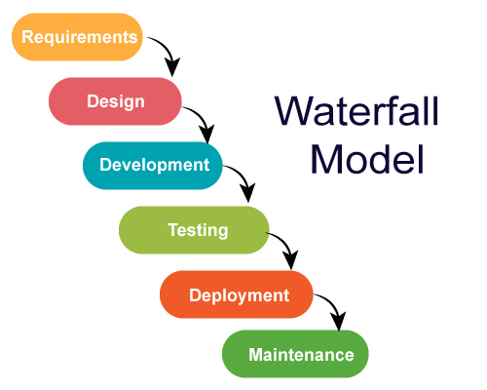
Project analysis slide 2
System Analysis
Waterfall methodology is used while building the website.
This project has specific documentation, fixed time, fixed requirements, well-understanding technology so in order to build this system waterfall methodology can be properly utilized.
Fig 1: Waterfall Model

Slide 7
Project analysis slide 2
Requirements
Functional requirement
User Module:
• User shall register and login the system.
• Users shall look at their cart detail.
• User shall get cart detail after updating each product.
Admin Module:
• Admin shall login the system.
• Admin shall add and delete products.
• Admin shall see the registered users.
• Admin shall privilege to delete the user
.
• Admin shall logout from the system.

Slide 8
Project analysis slide 2
Requirements
Non-Functional Requirement
Availability: It must be available 24/7 online.
Security: This system must be secure and the user’s information won’t be available for others for users’ privacy.
Performance: This system must be designed for smooth performance with optimization and good response
.

Slide 9
Project analysis slide 2
Requirements
Feasibility study
Technical feasibility: In order to design this system, it uses existing technologies, software and hardware so there is no technological hurdle to build this system.
Economic feasibility: The system development does not have any requirement of expensive hardware and software, and used software are mostly open source so development is economically feasible.
Operational feasibility: The proposed system is operationally feasible as it is reliable for all type of user i.e., whether or not the user has the knowledge of computer or not. It is simple and easy to use due to simple user interface and its operational feasible.
Schedule Feasibility: The system that we developed is scheduling feasible as it does not require more time for the development phase.

Slide 10
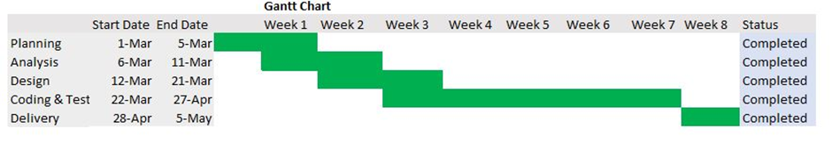
Project analysis slide 2
Requirements
Gantt chart is used for planning projects of all sizes, and it is a useful way of showing what work is scheduled to be done on a specific day.
It can also help you view the start and end dates of a project in one simple chart.
.
Fig 2: Gantt Chart

Slide 11
Project analysis slide 2
Requirements
Tools and Technology Used:
The Following software is used for the development of the System.
VS Code
MySQL
Apache [Xampp]
Minimum Windows 8 required.
.

Slide 12
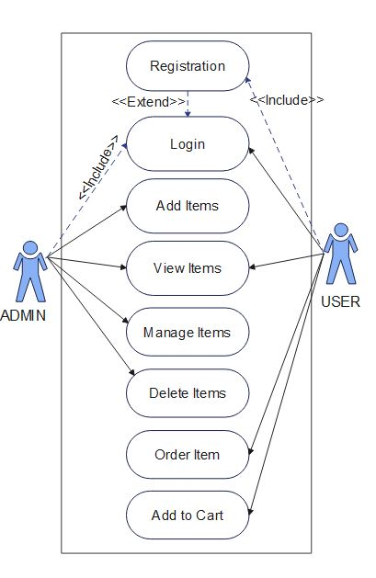
Project analysis slide 4
Use Case Diagram
Fig 3: Use Case Diagram

Slide 13
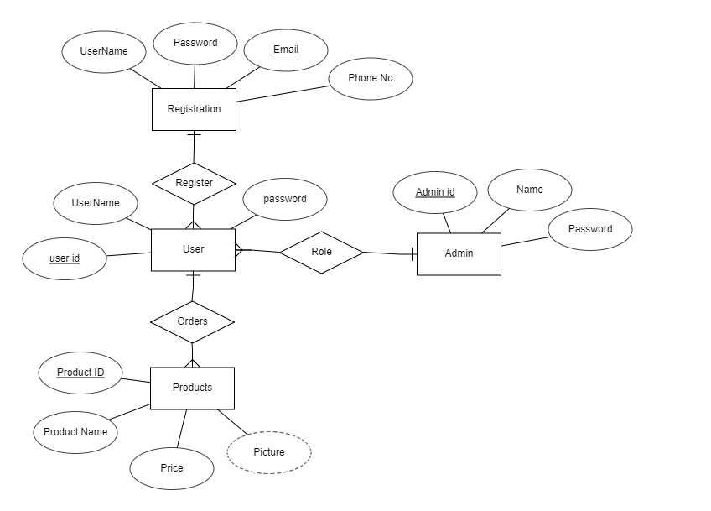
Project analysis slide 4
Entity Relationship Diagram
Fig 4: Entity Relationship Diagram

Slide 14
Project analysis slide 4
Process Modelling (DFD)
Fig 5: DFD Diagram (Level 1 DFD)

Slide 15
Project analysis slide 4
Implementation
Implementation usually consists of coding; testing, installation, documentation, training and support.
It is basically converting system design specification into working software.
Tools Used
1 HTML 1 PHP
2 CSS 2 MYSQL
3 JAVASCRIPT
4 BOOTSTRAP
FRONT END
BACK END

Slide 16
Project analysis slide 4
Implementation Details of Modules
Header: It displays the header with the logo of the shopping website, social media or the login. It is used in the navbar of the homepage. It is used in order to provide links to different pages of the website.
Breadcrumbs: It is used to automatically display the path taken to get to the page.
Register Form: It is used in order to register the new users to the website. It contains the text field like email, username and password. The information entered is further stored to be used in the login page.
Login Form: It is used in order to provide the user the gateway to the website. It uses the data like username and password from register form to authenticate the user and give further access.
Shopping Cart: It displays the quantity of products and the prices of the products which is to be bought by the user.
Product Modules: Since the shopping website offers two different Shopping categories, Product modules divides different products according to their categories. Users can select the products according io their choices.
User Module: It provides information related to the user. It Provides information like cart detail, product detail, login, register and logout
.
Admin Module: It provides information to the admin. It provides information like user detail, Admin can add or remove products etc.

Slide 17
Project analysis slide 4
Testing
Testing is done to check the behaviour of a complete and fully integrated software product based on the software requirement specification document. For the application or website to be deployed it has to be tested.
1.Verify that all the specified fields are present on the registration page.
2.Verify that clicking submits button after entering all the required fields, submits the data to the server.
3.Verify that not filling the optional fields and clicking the submit button will still send data to the server without any validation error.
4.Check validation on the phone no and email fields (only valid phone no and valid email Ids should be allowed).
5.Check validation on numeric fields by entering alphabets and special characters.
6.verify Cart by putting negative value and 0.

Slide 18
Project analysis slide 4
Testing Evidence
 | Test Case Description | Test Data | Expected Result | Actual Result | Pass/ Fail
A_LOG_1 | Admin enters an invalid email | username: 1324gmail.com password: 1234 | Display message **The email format is invalid. | As expected, | Pass
A_LOG_2 | Admin enters a wrong password | email:1234@gmail.com password:1234 | Display message ** Password mismatch** | expected | Pass
A _LOG_3 | Admin enters valid email and password | email:milankarki723@gmail.com password- user123 | Logged into Login page | As expected, | Pass
Register page test case
Fig: Register page test case
Table 1: Register page test case

Slide 19
Project analysis slide 4
Testing Evidence
 | Test Case Description | Test Data | Expected ResuIt | Actual Result | Pass,'Fai
A LOG | Admin enters a wrong email | email: 1324gmail.com password: 1234 | Display message **The email is not found* * | expected | Pass
A_LOG_2 | Admin enters a wrong password | email: 1234@gmail.eom password: 1234 | Display message **Password does not match ** | As expected | Pass
A_LOG_3 | Admin enters valid email and | email: milankarki723@gmail.eom password: user123 | log into Home page | As expected | Pass
Register page test case
Fig: Register page test case
Table 2: Login page Test case

Slide 20
Project analysis slide 4
Testing Evidence
ID | Test case Description | Expected Result | Actual Result | Pass,'FaiI
A_LOG_ | Adds Negative Value in cart. | The cart will not add the value less than 1 | As expected | Pass
A_LOG_2 | Add products in cart. | Product added | As expected | Pass
A_LOG_3 | Remove and update product in cart. | Product updated and removed successfully | As expected | Pass
Table 3: Shopping cart Test case

Slide 21
Project analysis slide 4
Outcome
When this project is completed, the users will be able to buy various products.
After filling the register form, user can view and buy different products online through web browser.
User can easily add and remove products from the cart.

Slide 22
Project analysis slide 4
Conclusion
After the successful completion of the shopping website, people can perform easy shopping online.
The current application has fulfilled all the objectives.
We followed the specifications strictly but enhanced some of the features when there was need it to be done.
There have been challenges especially when it came to backend and making sure that the application responses in a predictable manner.
Choosing PHP for this project is because it is very simple and easy to use, it could handle a lot of data and easily manipulation compared to another scripting language, this is widely used all over the world. it is Open source; we can freely download and use. And it is platform independent as well.

Slide 23
Project analysis slide 4
Future Recommendation
Here is what can be added in the future on this website to increase its usability, user experience and portability of the website. There is a lot to be done hence this application can be considered as a starting point for something big to come
Addition of transaction methods
Access the applications on a small device (mobile app),
Addition of new shopping categories.
Making project device compatible.
Advance Shopping cart

Slide 24
Project analysis slide 4
Reference
[1] | techtarget.com, “techtarget.com,” 21 8 2015. [Online]. Available: https://www.techtarget.com/searchcio/definition/e-commerce. [Accessed 2022 3 3].
[2] | Ramesh singh saudh , Software Engineering, Ktm: KEC Publication, 2020(Revised).
[3] | onlinevisualparadigm, “onlinevisualparadigm,” onlinevisualparadigm, 1 1 2001. [Online]. Available: https://online.visual-paradigm.com/app/diagrams/#diagram:proj=0&type=UseCaseDiagram&gallery=/repository/b3387898-edd8-4801-b76d-16c753a22ded.xml&name=Use%20Case%20Diagram%3A%20Bulletin%20Board%20System. [Accessed 4 3 2022].
[4] | erdplus.com, “erdplus.com,” erdplus.com, 17 12 2000. [Online]. Available: https://erdplus.com/standalone. [Accessed 4 3 2022].
[5] | canva.com, “canva,” canva.com, 7 3 2005. [Online]. Available: https://www.canva.com/design/play?category=tADWs1ZQ3GI&type=TACQ-lCLuV8&uid=4e4ac7bf-8042-4965-b8e9-31ed6de54892&_branch_match_id=1027966197395974451&utm_source=landing-page&utm_campaign=gantt-charts&utm_medium=graphs-pages&_branch_referrer=H4sIAAAAAAAAAw. [Accessed 3 3 2022].

Slide 25

Project analysis slide 4
APPENDICES
Fig 1: Admin Login

Slide 26
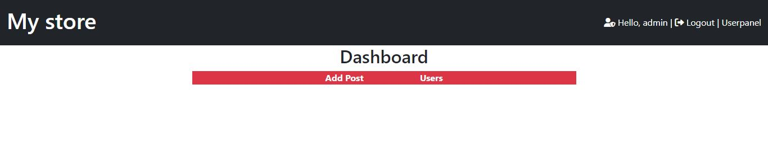
Project analysis slide 4
APPENDICES
Fig 2: Admin Home Page

Slide 27
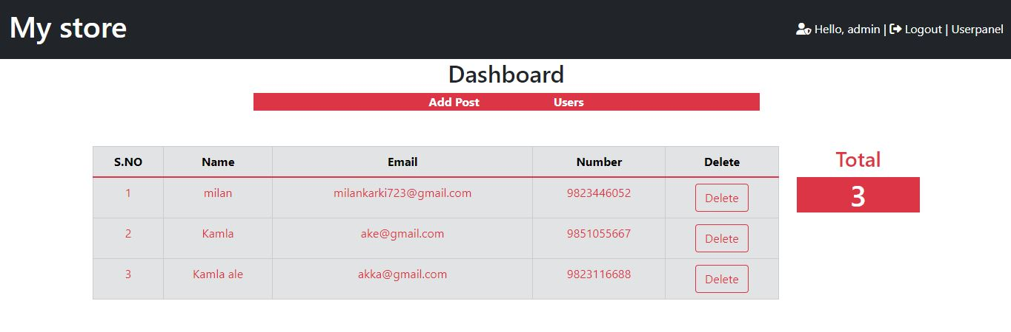
Project analysis slide 4
APPENDICES
Fig 3: Admin Manage User Page

Slide 28
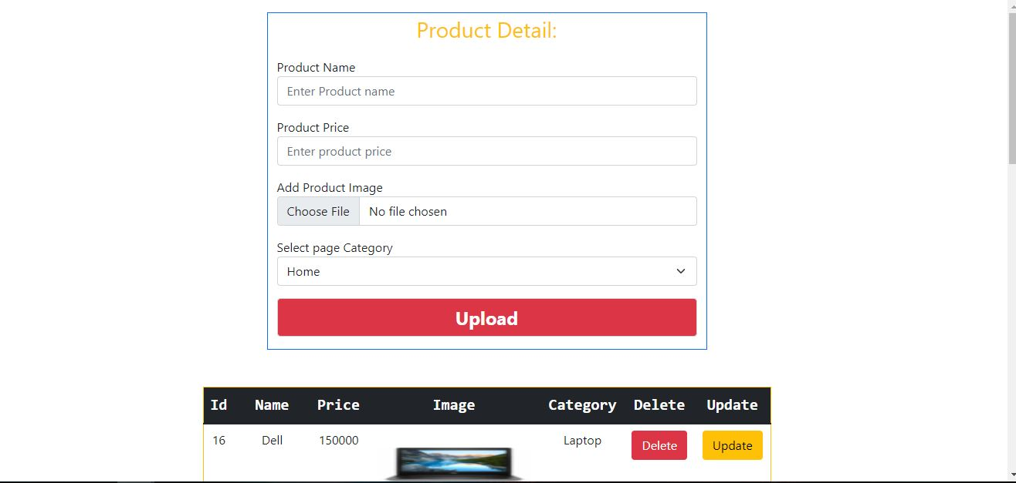
Project analysis slide 4
APPENDICES
Fig 4: Admin Add post Page

Slide 29
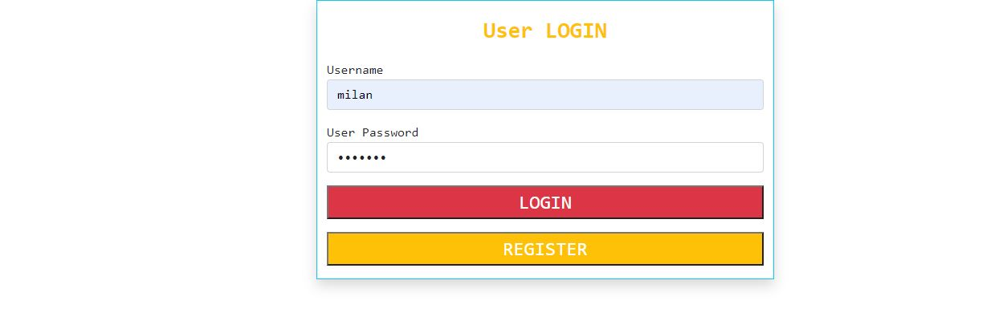
Project analysis slide 4
APPENDICES
Fig 5: User Login Page

Slide 30
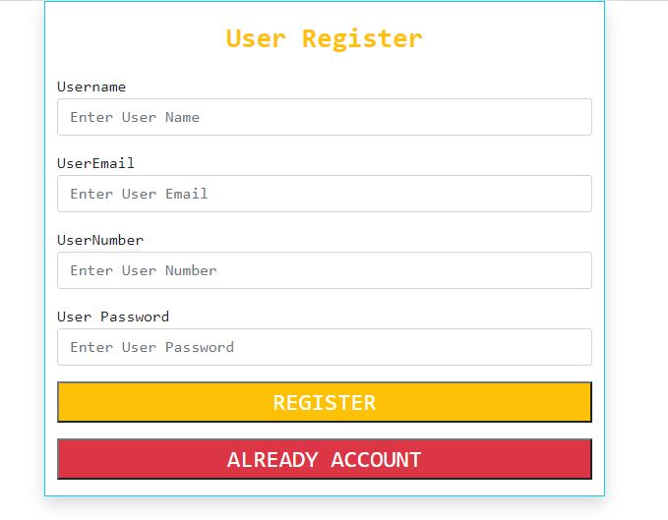
Project analysis slide 4
APPENDICES
Fig 6: User Registration Page

Slide 31
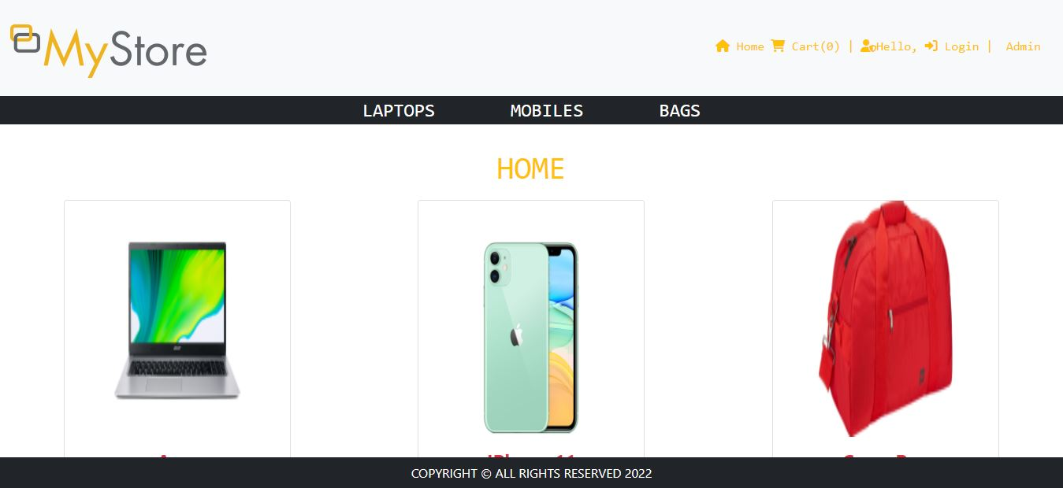
Project analysis slide 4
APPENDICES
Fig 7: Home Page

Slide 32
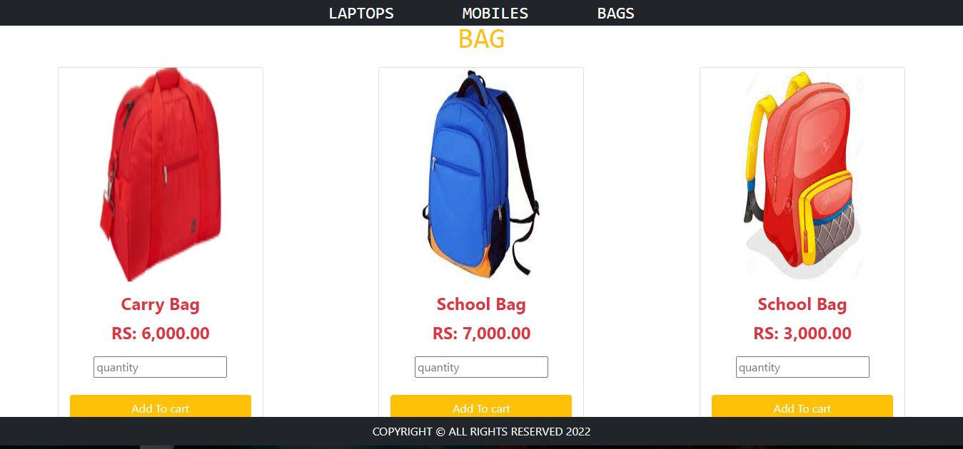
Project analysis slide 4
APPENDICES
Fig 8: Bag Page

Slide 33
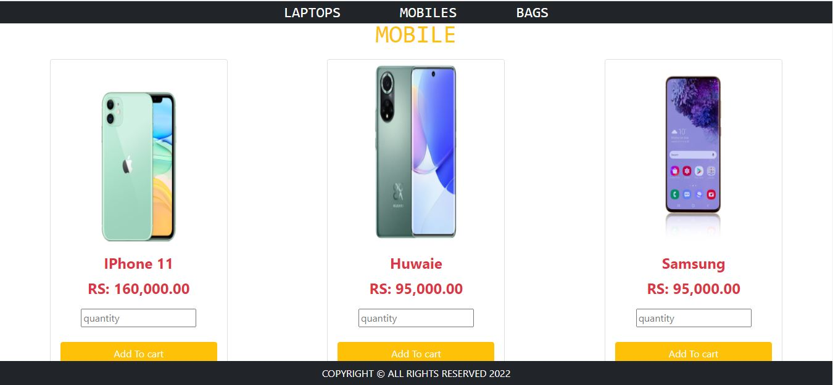
Project analysis slide 4
APPENDICES
Fig 9: Mobile Page

Slide 34
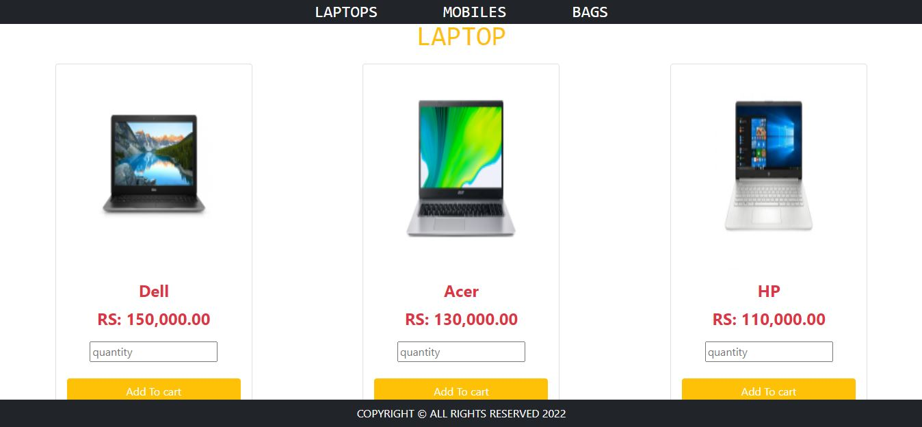
Project analysis slide 4
APPENDICES
Fig 10: Laptop Page

Slide 35
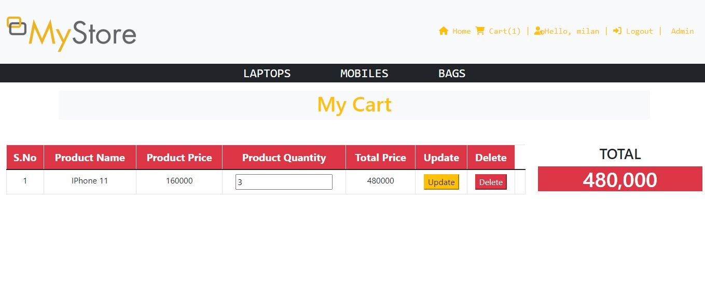
Project analysis slide 4
APPENDICES
Fig 11: Cart Page

Slide 36

Project analysis slide 4
Any Question?

Slide 37
Thank You

